Slide 1



AMAZON SALES ANALYSIS
​

Slide 2


Agenda
Introduction
Details of sales data
Main KPI’S
My design
Amazon sales analysis report

Slide 3

Introduction
Sales management has gained importance to meet increasing competition and the
need for improved methods of distribution to reduce cost and to increase profits. Sales
management today is the most important function in a commercial and business
enterprise.

Slide 4
Details of sales data
Region
Country
Sales channels
Order details
Order priority
Order ID’S
Units sold
Unit price
Total cost
Total revenue
Total profit

Slide 5
Main kPI’s
1.Total revenue
2.Total profit
3.Total cost
4.Total units sold
5.Total revenue by year
6.Total revenue by month
7.Total revenue by item type
8.Total revenue by channel
9.Total revenue by order priority

Slide 6
Main kPI’s
10.Top 10 revenue generated by countries
11.Top 10 revenue generated by region
12.Top 5 item types sold
13. Bottom 5 item types sold
14.Top 5 revenue generated order id’s
15.Total revenue forecast
16.Profit by item type
17.Count of units sold by region
18.Slicers (order year, region country)

Slide 7
MY DESIGN

Slide 8
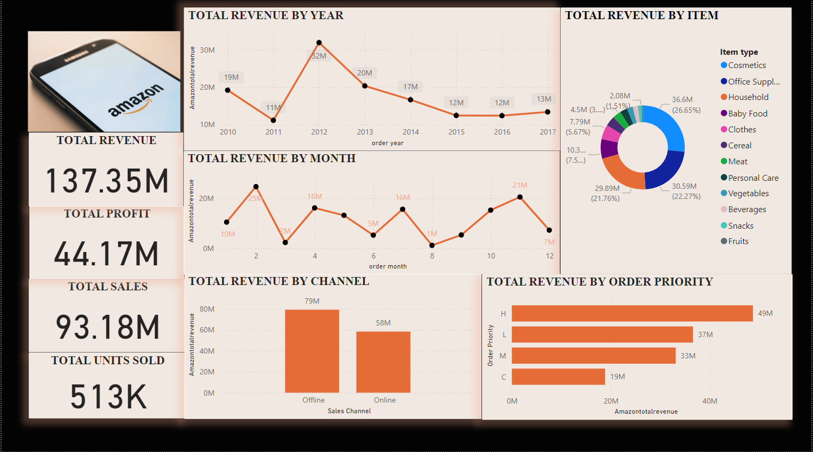




Meet our team
Takuma Hayashi​
Mirjam Nilsson​
Flora Berggren​
Rajesh Santoshi​
President
Chief Executive Officer
Chief Operations Officer
VP Marketing

Slide 9
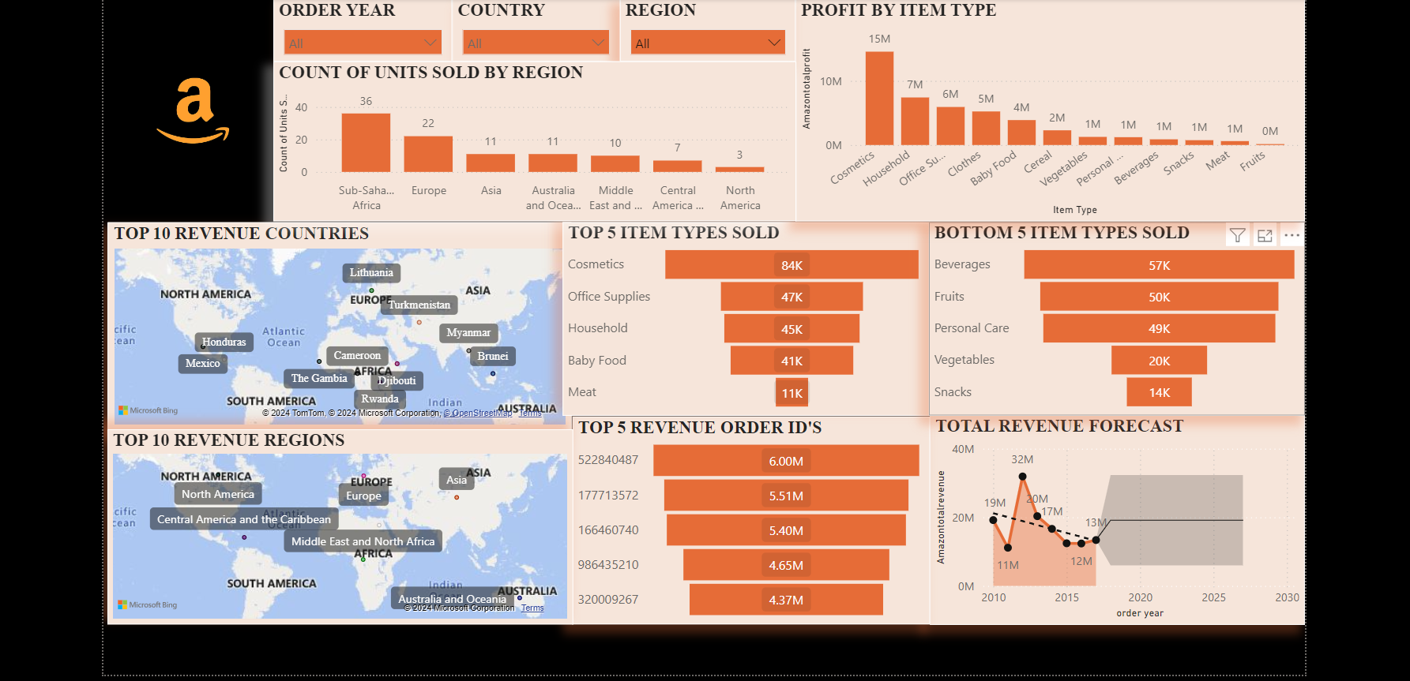








Meet our extended team
Takuma Hayashi​
Mirjam Nilsson​
Flora Berggren​
Rajesh Santoshi​
President
Chief Executive Officer
Chief Operations Officer
VP Marketing
Graham Barnes
Rowan Murphy
Elizabeth Moore
Robin Kline
VP Product
SEO Strategist
Product Designer
Content Developer

Slide 10
Amazon sales analysis report

Slide 11
Amazon sales analysis report
Total revenue generated between 2010-2017 is 137.35m
Total profit generated between 2010-2017 is 44.17m
Total costs generated between 2010-2017 is 93.18m
Total units sold between 2010-2017 is 513k
In 2012 high revenue generated with 32millons
In 2011 revenue was low with 11millons
major profit generate items are cosmetics with 14.56m, household with7.14m and office supplies with 5.93m
major revenue generated items are cosmetics with 36.6m,office supplies with 30.59m
Less profit generated item was fruits with 0.12m

Slide 12
Amazon sales analysis report
Through offline major revenue is generated up to 79millons between 2010-2017
Total units sold by region is high in subsaharam Africa between 2010-2017
And lower units sold by region is north America between 2010-2017
Majorly sold units are cosmetics with 84k between 2010-2017
Snacks are less sold item between 2010-2017
Top revenue customer id is 522840487 with 6.00millons between 2010-2017
Top revenue generated by country is Honduras
Bottom revenue generated country is kuwait

Slide 13
Thank you
HARIPRIYA THANGELLAPALLI
Internship ID: UMIP14324

